Slide 1
BITCOIN PRICE PEDICTOR
TANISHKA PURWAT

Slide 2

INFO
1
2
3
4
GREAT INVESTMENT
Profit from its price fluctuations
Hedge against inflation
AIMS
Help assess the overall future trend
Look out for multicollinearity and overfitting
Understanding who the drivers are
USEFUL FOR
Investments
Speculation
Risk Management
POTENTIAL CLIENTS
Trading Firms
Hedge Funds
Crypto Exchanges
Fintech Startups

Slide 3


DATA SELECTION AND PREPARATION
Kaggle dataset
17’515 rows x 131 columns
Cryptocurrency pairs info (open, high, close, volume)
Commodities (crude oil, gold, corn)
Global stock indices (NASDAQ, DAX, S&P 500)
Handling missing values
Features with mainly “NaN” values: deleted
Time stamps turned to features
Numeric columns normalised
Target Variable: “BTC_USDT_1h_close”

Slide 4
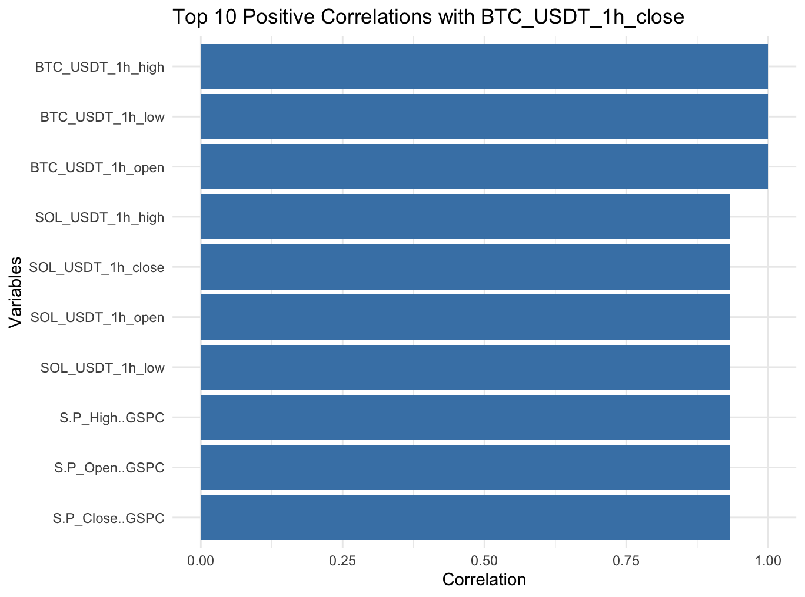
VARIABLE SELECTION AND MULTICOLLINEARITY
Correlation Analysis
BTC-related variables (BTC_USDT_1h_open, high, and low) were dropped
Features with a VIF value of more than 10 were removed.
Resulted in 30 predictors

Slide 5

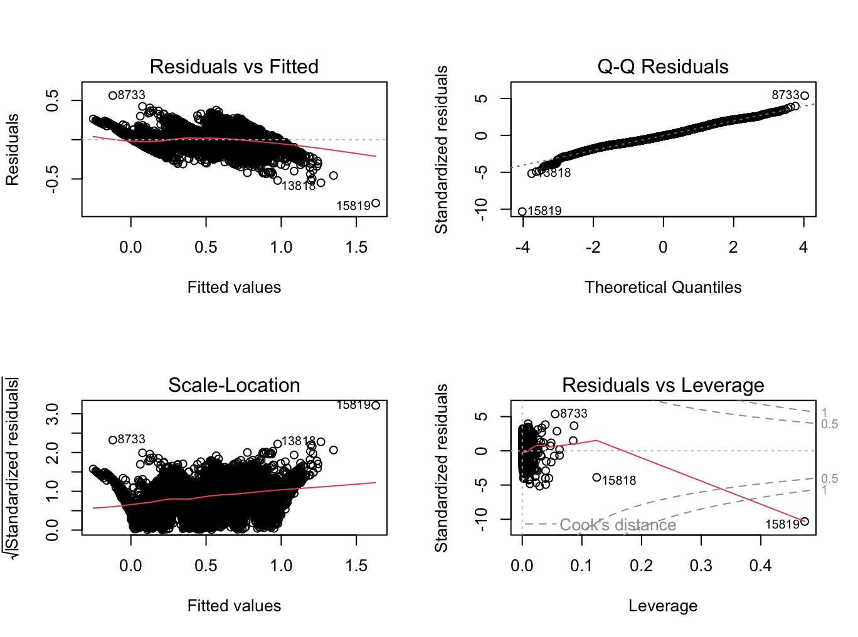
MODEL 1: NORMAL LINEAR MODEL
RESULTS
Adjusted R^2 = 0.8622
significant predictors included “funding_rate”, “google_trends_buy_crypto”
CROSS VALIDATION
10-fold Cross Validation
RMSE = 0.108
MAE = 0.0854
R^2 value = 0.8608445
RESIDUAL ANALYSIS
Violates the linear model assumptions.
Heteroscedasticity
Non-linearity
Major Outliers
Notes:
the RMSE was noted as 0.0807, which shows that the predictions made are closer to the actual value on average. The R^2 was noted as 0.9183, meaning that more variance in the target variable can be explained than ever before. Lastly, the lower MAE further reflects improved model accuracy. These findings indicate strong generalisation performance and a reduced prediction error.

Slide 6
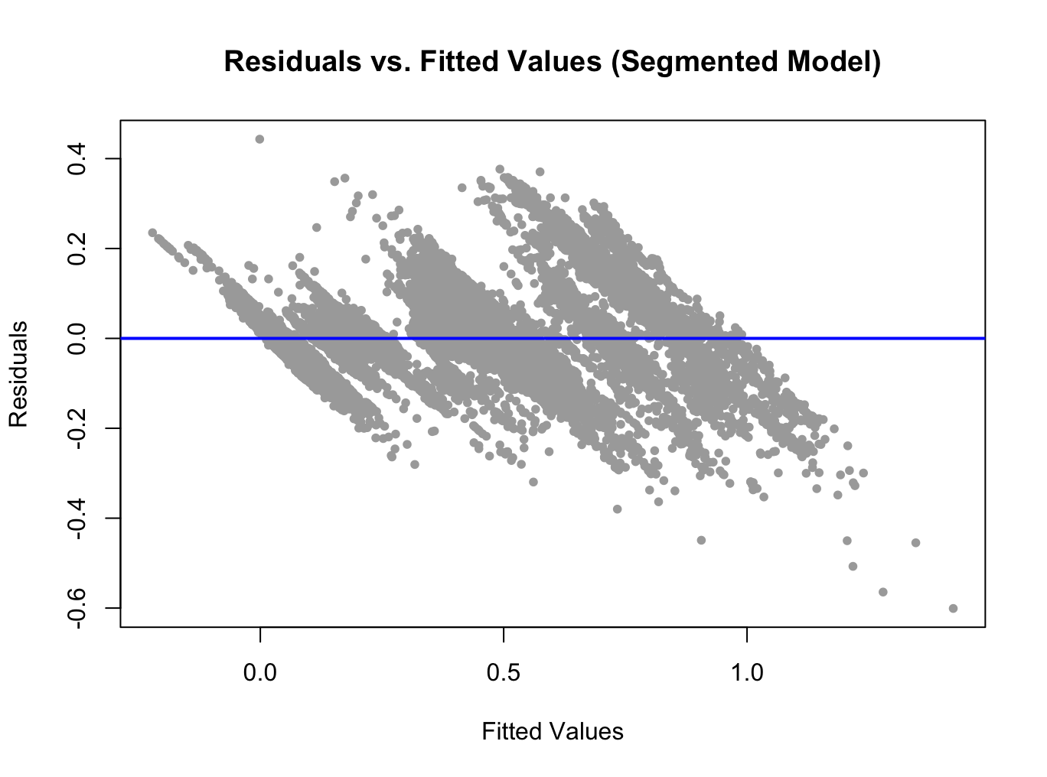
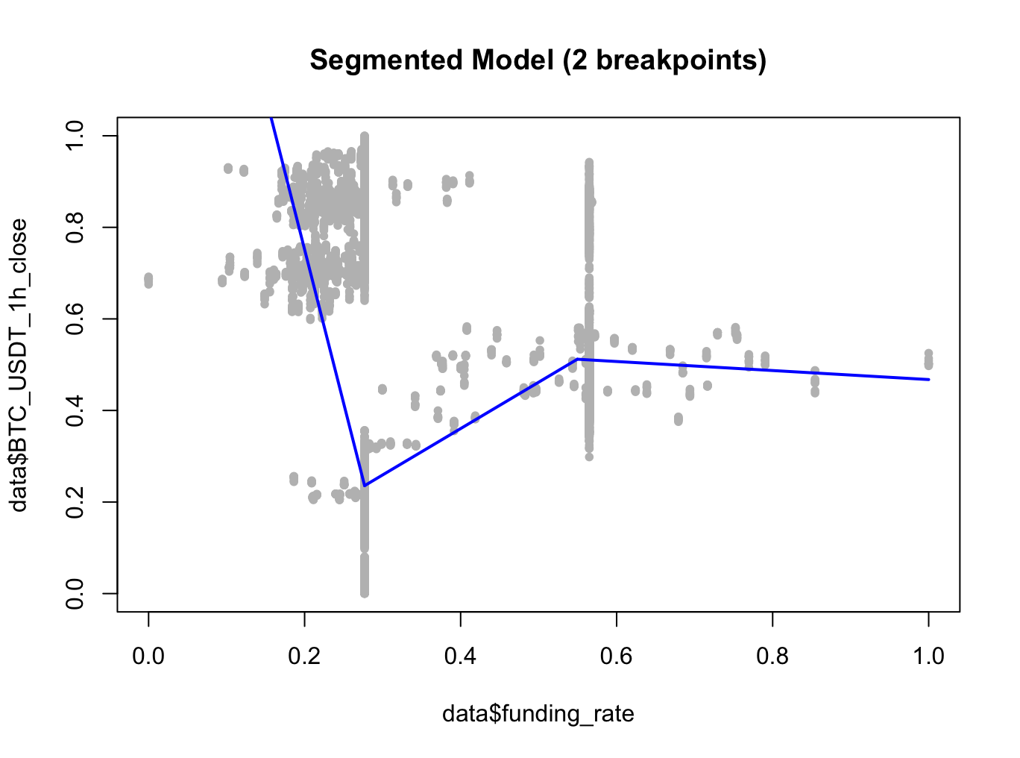
MODEL 2: PIECEWISE LINEAR MODEL
RESULTS
RESIDUAL ANALYSIS
Adjusted R^2 = 0.883
Two knots at 0.277 and 0.550 using “funding_rate”
Violates the linear model assumptions.
Improvement in heteroscedasticity
Non-linearity
Major Outliers

Slide 7
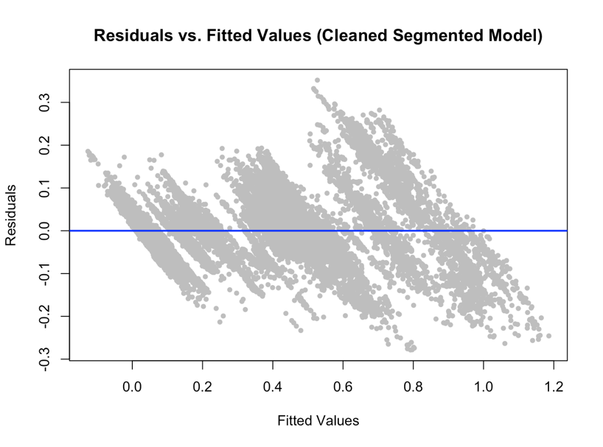
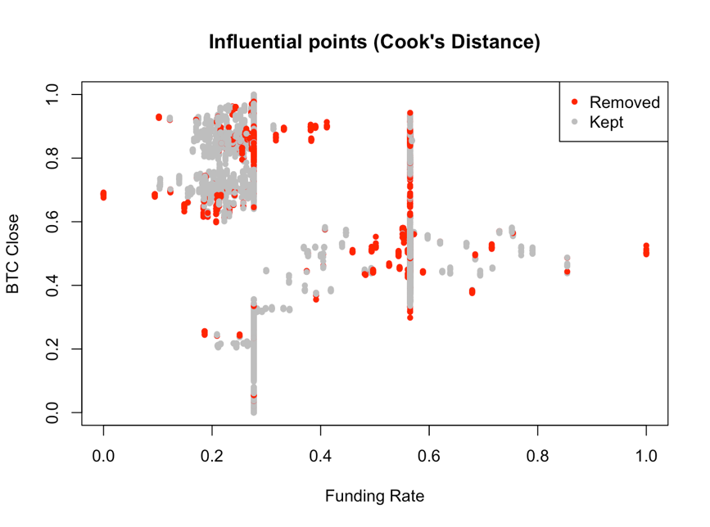
MODEL 3: CLEANED PIECEWISE LINEAR MODEL
RESULTS
RESIDUAL ANALYSIS
Adjusted R^2 = 0.9366
Two knots: 0.335 and 0.562 using “funding_rate”
Influencial predictors: “google_trends_buy_crypto”, “cattle_Close.LE.F”
Violates the linear model assumptions.
Improvement in heteroscedasticity
Non-linearity
Major Outliers deleted

Slide 8
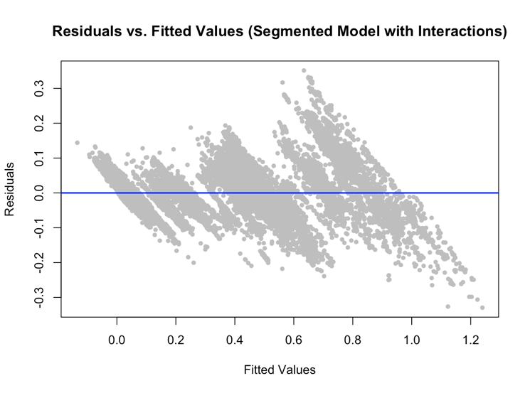
MODEL 4: PIECEWISE LINEAR MODEL + INTERACTION TERMS
TERMS ADDED
“funding_rate” * “fear_greed_index”: how funding_rate affects prices
“funding_rate” * “weekend”: how weekends affect funding_rate
“google_trends_buy_crypto” * “fear_gread_index”: how public interest affect market sentiment
RESULTS
RESIDUAL ANALYSIS
R^2 value = 0.9366
Interaction terms had a p-value <0.001
Violates the linear model assumptions.
Improvement in heteroscedasticity
Non-linearity
Major Outliers deleted

Slide 9
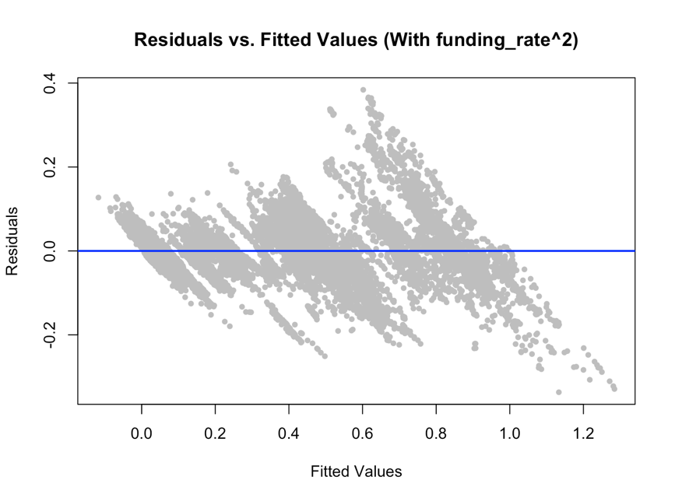
MODEL 5: PIECEWISE LINEAR MODEL + INTERACTION + NON LINEAR TERMS
QUADRATIC TERM ADDED
“(funding_rate)^2”: to capture curvature in the relationship between target variable
Introduce curvature to segments
RESULTS + CROSS VALIDATION
Adjusted R^2 value = 0.9416
Non-linear term had a p-value <0.001
RMSE: 0.0807
R^2: 0.9183
MAE: 0.0613
RESIDUAL ANALYSIS
Does not violate the linear model assumptions.
Improvement in heteroscedasticity
Improvement in Non-linearity
Major Outliers deleted
Notes:
the RMSE was noted as 0.0807, which shows that the predictions made are closer to the actual value on average. The R^2 was noted as 0.9183, meaning that more variance in the target variable can be explained than ever before. Lastly, the lower MAE further reflects improved model accuracy. These findings indicate strong generalisation performance and a reduced prediction error.

Slide 10
COMPARISON
Methodology | Residual Std. Error | Adjusted R^2 | Breakpoints (Funding Rate)
Model 1: Basic Linear Model | 0.1075 | 0.8622 | -
Model 2: Segmented Model | 0.099 | 0.8832 | 0.333, 0.565
Model 3: Segmented Cleaned Model | 0.0798 | 0.9200 | 0.335, 0.562
Model 4: Segmented Model with Interaction Terms | 0.0711 | 0.9366 | 0.328, 0.560
Model 5: Segmented Model with Interaction and Non-Linear Terms | 0.0682 | 0.9416 | 0.276, 0.278
Metric | Model 1 | Model 5
RMSE | 0.1081 | 0.0807
R^2 | 0.8608 | 0.9183
MAE | 0.0854 | 0.0613
Highlights the superiority of Model 5 in generalizability and real-world forecasting utility compared to the initial Model 1.

Slide 11
RESIDUAL ANALYSIS
Does not violate the linear model assumptions.
Improvement in heteroscedasticity
Improvement in Non-linearity
Major Outliers deleted

Slide 12

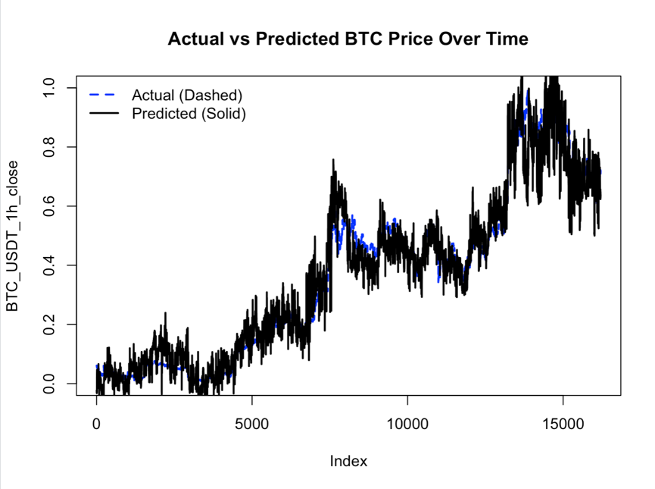
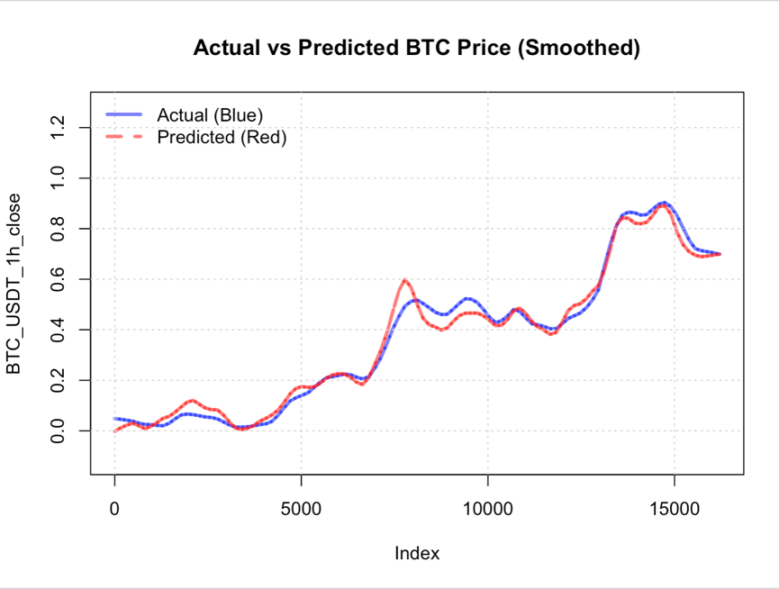
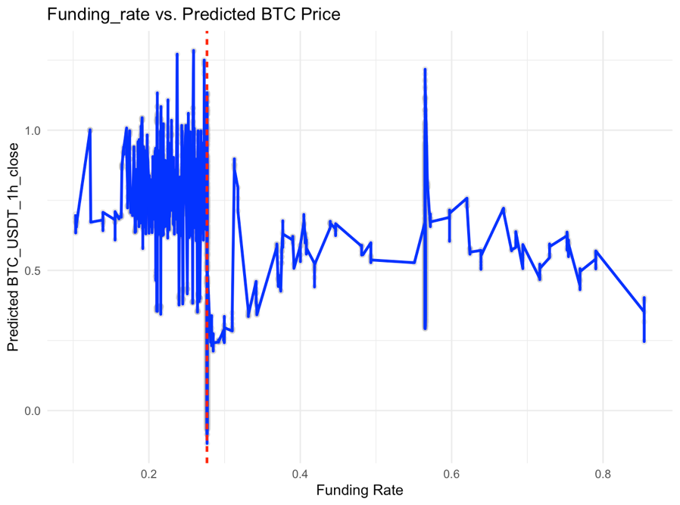
DISCUSSION AND CONCLUSION
GRAPH 1
BTC closing time normalised
GRAPH 3
Adapts well to sharp behavioural shifts in market
GRAPH 2
Easier on the eyes
Model generalises data well

Slide 13
TOP 5 INFLUENCIAL PREDICTORS
1
2
3
4
5
“google_trends_buy_crypto”
Indicates public interest
Grows speculative momentum
“cattle_Close.LE.F”
Cattle futures’ closing price
Investors may opt for BTC to hedge against food-price volatility
“S.P_Volume..GSPC”
S&P 500 Index
Reflects Investor Sentiment
High interest may spill over to BTC
“google_trends_buy_crypto:fear_greed_index”
Added interactive term
Captures how public interest affects market sentiment
“Dow_Volume..DJ”
Dow Jones Industrial Average
Same as S&P 500 Index

Slide 14
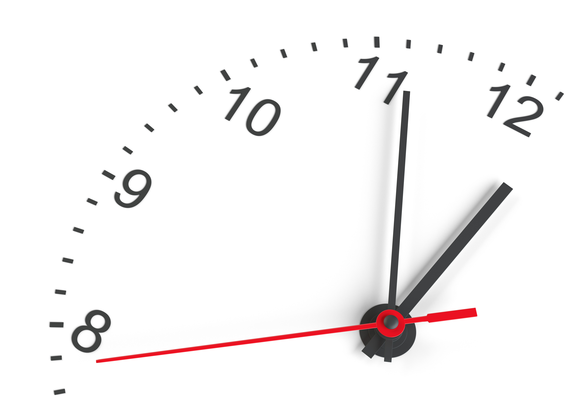
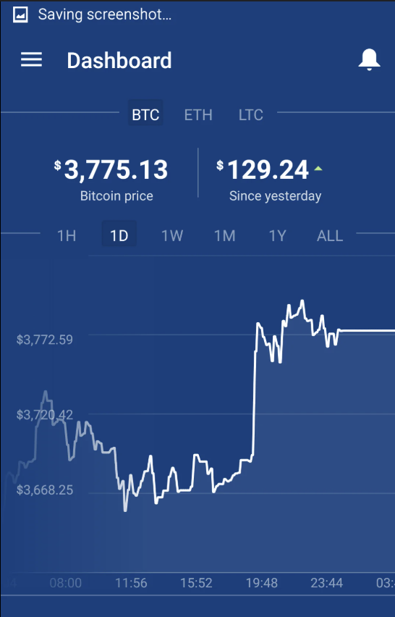
MODEL RECOMMENDATIONS
SMALL PREDICTION ERROR = BIG REAL WORLD CONSEQUENCES
Model RMSE: 0.081
Corresponds to BTC prices over $50’00
Potential Deviation of $4’000
Inefficient Hedging
Risk of losing Oppurtunity Cost
TECHNICAL ADDITIONS
Feature Engineering to include lagged BTC prices
Including LSTM
Integrating with real-time Data
Elevated live dashboard

Slide 15
THANK YOU FOR LISTENING

